Slide 1

Warehouse of the Future
Lakes Vs Marts
Simon Whiteley| Adatis
06/04/2016
Notes:
Hello! Thanks for taking the time to download my slides – hope they’re helpful.
If you have any questions or comments, my contact details are at the end, feel free to get in touch!
Cheers,
Simon

Slide 2
Why Cloud?
Azure Data Warehouse
Azure Data Lakes
The New BI Architecture
Q & A
Notes:
The talk is aimed at roughly an hour – the main talking points being:
The drivers behind the move to the cloud, why people are doing it and what it means to traditional approaches. There’s a quick recap of those “traditions” and why they came about.

Slide 3
Notes:
So, what are we talking about? Well firstly, there’s a growing trend towards cloud technology. There’s a few reasons for this:
1 – It’s Cheap! Storage is super cheap! You can turn things off, or scale them down and save yourself money. Have you tried saving money by turning your server room off? It doesn’t work too well.
2 – It’s Quick! Compared to provisioning hardware, you can create Azure environments in minutes. Sure, you still need to think about network architecture, firewalls, security and the like. But once you’ve decided what you’re doing, it’s SO QUICK to set up. You can literally sign up to a trial and be working on a brand new, templated SQL Server within 5 minutes.
But the fact that the cloud is becoming more prevalent isn’t what we’re here to talk about. It’s the fact that the technology behind it is changing how we should work.

Slide 4
Management Responsibility
Notes:
There are one or two bits of cloud terminology I want to get out of the way first. The chart represents how much personal responsibility you take for different types of service offering, and how much is done for you.
Way over on the left, we have traditional on-prem. The hardware is your problem, storing the server somewhere is your problem, managing the windows installation and patching is your problem. Basically, you’re responsible for absolutely everything once the system has been installed and turned on. Sure, you may have a replacement guarantee if a hard-disk melts, but it’s still your responsibility to call someone out to fix it.
Next we have infrastructure as a service, or IaaS. It’s basically renting a virtual machine as a cloud service. You don’t know what the VM host looks like, you don’t know anything about the physical hardware, that’s not your problem. However, once the VM is up and running, everything else is yours. Patching the OS, installing software, managing security and permissions, firewalls, everyting. So there’s this nice split of responsibility – you can happily ignore hardware whilst managing software.
Then we have Platform as a Service, or PaaS. This is another step away – you’re given a working foundation on which to build whilst everything else is done for you. In the case of Azure SQL DB, you don’t need to know what OS it’s running on, or the physical hardware, or even the software version. Microsoft patches the database, takes backups, records analytics and generally manages it for you – I know quite a few DBAs who are horrified by that thought.
Then there’s SaaS – Software as a Service, basically a web application that you log on and use, you don’t know what database technology they use, or their architecture approach, you’re simply interested in the app.
So – with BI we’ve had limited choice here. Azure SQL DB has been pretty restricted for true BI, the “enterprise warehouse” doesn’t quite sit without some of the warehousing features we’re used to. And so we tend to take an IaaS approach, we install SQL Server on a VM. Sure, we can turn it off when we’re not using it and save some cash, we can even distribute across servers and power them up/down independently. Need SSRS at night but not SSIS? Turn off your SSIS box!
But that /was/ the case. It’s no longer the case – we’re getting some new toys to play with.

Slide 5
Notes:
That’s what this talk is about. Times are changing, new cloud technologies are coming out, but even now we use Azure in a very traditional approach, clinging to the old ways.
But what are the old ways? And what made them that way?

Slide 6
Traditional Warehouse Architecture
SSIS
SSIS
SSIS
Stage
Clean
Warehouse
Notes:
This should be familiar to any warehouse developers or architects out there. It’s the most basic data loading approach out there and super standard across many industries.
You grab source data from various places using SSIS and dump it in a common staging database.
You pick it up again and apply data cleaning, validation, harmonising and so on. You might pop it into MDS and back. Essentially, you perform some transformations.
We then grab that cleaned data and transform it into our warehouse data models, usually a Kimball-style star schema with key lookups and all that jazz.
Why do we do it this way? Well because generally SSIS is very fast compared to performing the same action on a database engine. If we need to process tens of millions of rows, we pull the first 10,000 into memory, begin our first task, maybe converting data types. When that’s done, we start the next task on that 10,000 – adding computed columns this time, but while we do that we bring the next 10,000 into memory and put them through the first task. In this way we have a pipeline of transformations happening purely in memory. It’s historically been the most effective, maintainable approach.
Taking a step back, we’re following the same pattern – we extract, we transform, then we load.

Slide 7
ETL
Notes:
EXTRACT, TRANSFORM, LOAD
That’s the mantra of the warehouse developer. It’s so prevelant that tools such as SSIS, Talend, Datastage etc are known as ETL tools.
But this is the assumption we’re here to question. Just because ETL was the right approach previously, we now have access to radically different tech.

Slide 8
?
On Prem
Azure
AzCopy
SSIS Feature Pack for Azure
Azure Storage Explorer
SSIS C# Task
+ More!
Notes:
Before we crack on, this talk is NOT about getting data into Azure. There are loads of different methods, and they’re all very straightforward. Take your pick of your favourite and go for it.
The rest of the talk assumes you’ve managed to get your data into Azure blob storage already!

Slide 9
Why Cloud?
Azure Data Warehouse
Notes:
Alright – foundations laid, on to the interesting things!

Slide 10
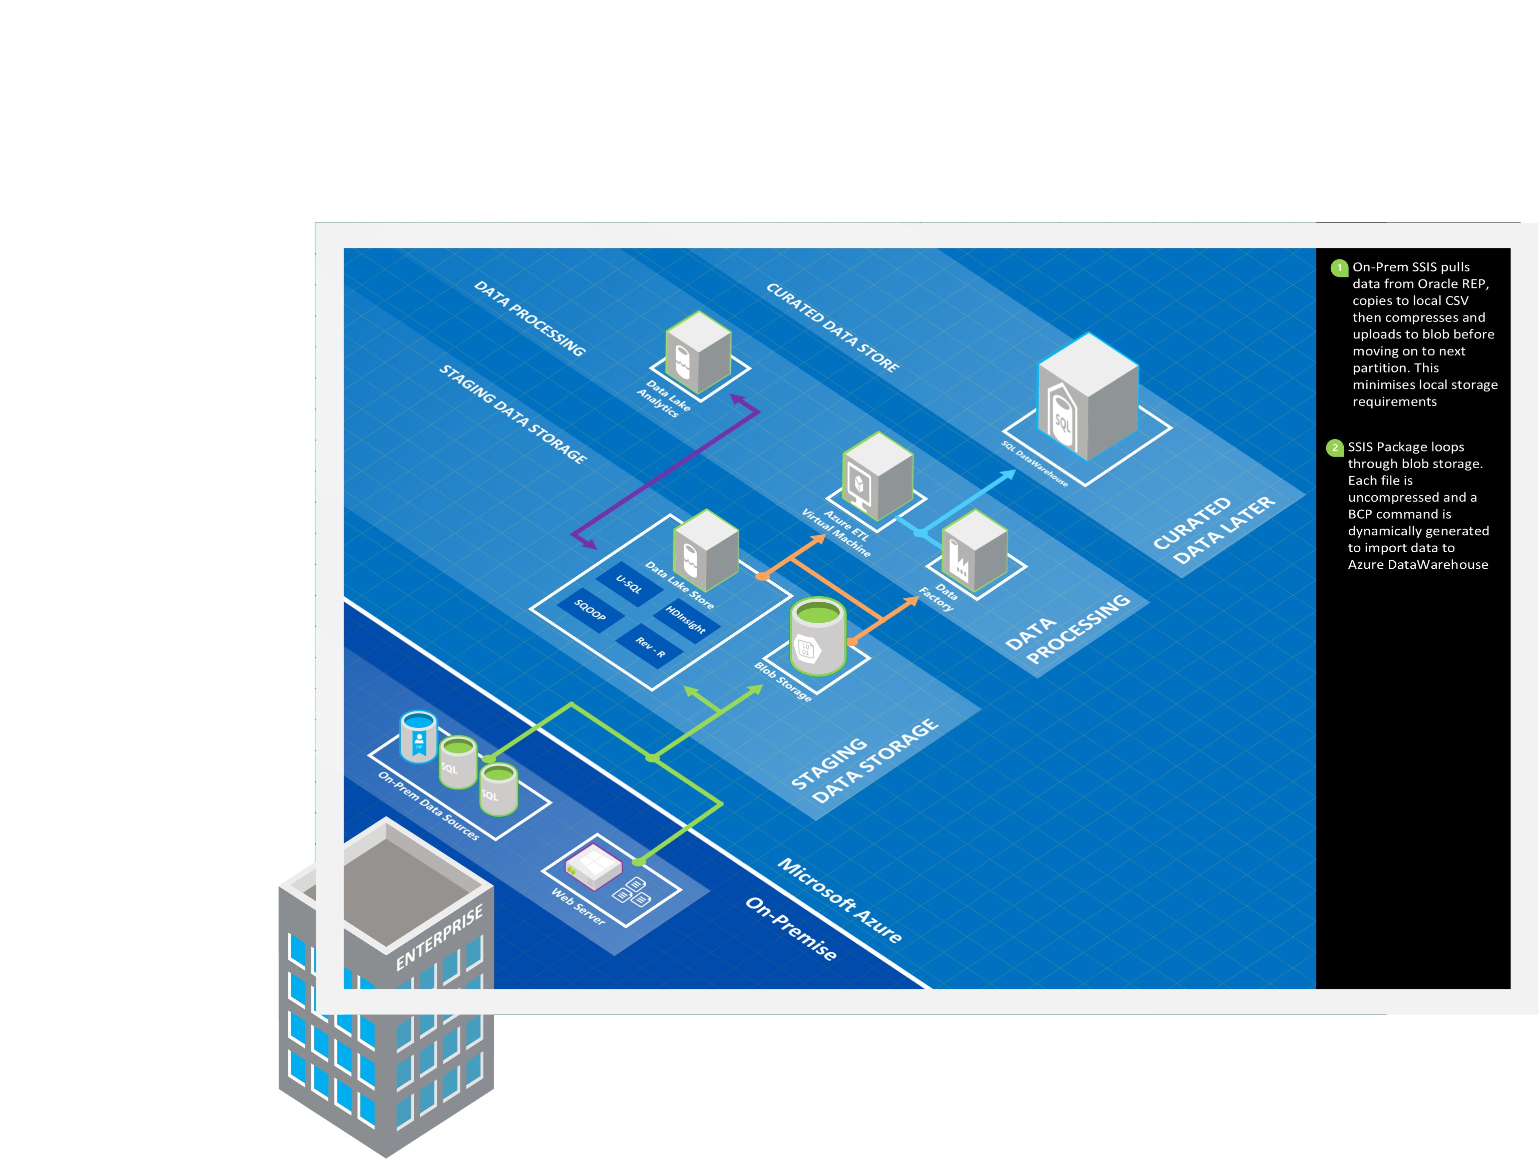
Data
Warehouse
Massively Parallel Processing
Clustered ColumnStores
Distribution & Partitioning
Notes:
SO – What’s Azure DataWarehouse and why is this man so excited about it?
Well most people have heard of PDW – Parallel Data Warehouse, which was later rebranded as APS. Azure DataWarehouse is essentially APS in the cloud. It’s not identical, but it reuses the APS database engine, it performs due to similar principles. It’s very much an MPP appliance (Massively Parallel Processing for the non-geek).
The main storage engine is using clustered columnstores, so it compresses data very well and it’s QUICK.
But why is it quick and how does this work? Well to understand this, you need to be aware of Distribution and Partitioning. In a nutshell, you have a ton of small servers working in unison. You want to maximise the number of servers doing the work – that’s distribution. But you don’t want each server to be doing more work than it needs to, so you can use traditional partitioning to minimise data work.
So when you run a query, to be fast, you want LOTS of distribution whilst ELIMINATING partitions. But I think we need a better example, let’s take a look at the on-prem APS approach.
HOURLY CHARGE
DISTRIBUTED NODES = HOW DOES APS SCALE?

Slide 11
PDW/APS Scaling
Control
¼ Rack
8 Readers
8 Writers
8 Distributions
Notes:
APS comes in quarter racks – you have a control node in each full rack and the first ¼ rack provides 8 readers, writers and distributions. Essentially, your data is spread across 8 different SQL Servers, each of which has a thread for reading and writing data.
Want it to go faster? You give you friendly Microsoft a call and a large bag of money and you ramp up to…

Slide 12
PDW/APS Scaling
Control
¼ Rack
¼ Rack
16 Readers
16 Writers
16 Distributions
Notes:
A half rack. You’ve literally doubled your processing capacity and if you data is evenly spread across your distributions, you can effectively double performance. 16 readers, 16 writers each interacting with one of 16 data distributions.
If that’s not fast enough and there’s budget burning a hole in your pocket….

Slide 13
PDW/APS Scaling
Control
¼ Rack
¼ Rack
32 Readers
32 Writers
32 Distributions
¼ Rack
¼ Rack
Notes:
You can keep scaling up and getting linear performance improvements.
However, when we’re adding this new rack, we literally have to take the data that’s spread across 16 nodes and spread it acorss 32. There’s a lot of data movement, it’s not a quick task. But you’re not scaling on the fly – you can’t have a guy down in the server room plugging racks in and out to cater for demand, it would be massively inefficient and it’s not like you stop paying for those racks when they’re out!
That’s APS on-prem. But we really want to know about Azure DW – how does that manage to scale? You can literally move a slider and get similar performance improvements within minutes, no matter your data size.

Slide 14
60 Distribution Nodes
600,000,000 Records
Notes:
The answer is that distribution nodes have been divorced from the readers and writers. Azure DW has a fixed number of distributions – this is currently 60 in the preview of ADW. Your distributions are always allocated to one of the 60 processing nodes.
So how to we distribute data properly? Well firstly, there’s an approach called Round Robin – each record coming in will be put on the next node in a sequence, forcing an equal distribution of data. This is the default approach and the most straightforward, but it’s not the most performant.
The alternative is to pick a column to perform a Hash distribution on. However by specifying your own distribution method, there are some common pitfalls.

Slide 15
60 Distribution Nodes
Notes:
This is what we’re aiming for – 60,000,000 records split evenly across our distributions so there are roughly 1,000,000 records on each node. But what if we hadn’t thought too much about what kind of queries would be handled by the data.
Let’s say we distributed based on client key. We’ve got way more than 60 clients (having less would mean there are nodes with no data on it!) and the data is evenly spread. Sounds good?

Slide 16
Distribute by client – select * where clientId = 321
Notes:
If a common query to be run against the warehouse uses the ClientKey in the where clause, ie: it’s a common search predicate, we’ve essentially allocated all of our work to a single node. That node has all of the records associated with our client and so has to crunch through the numbers for the entire order history.

Slide 17
Distribute by other – select * where clientId = 321
Notes:
If we had a different distribution hash, then each of our nodes would be able to do a little work. The total time of the query in this scenario would be the slowest node, all of which should be much faster than our single node working alone.
This is a pretty simple example where we’re only talking about querying a single table. In this example we might as well have used a round robin distribution.
However, when your query joins multiple tables, it gets interesting. Each individual node still needs to work in isolation, but if some of the records it needs to complete it’s query are on a different node, then we have to temporarily make a copy of the data. This is known as data movement and we generally want to minimise it when running queries. But if we have distributed all tables in the query on the same distribution hash, then each node can run it’s query without referring to other nodes’ data and we get the real performance benefits of MPP.
Ok. So that’s distribution in a nutshell, there’s a lot more to it, but hopefully that’s enough of a grounding to get you started.
But it raises a question – if we always have 60 distributions, how do we scale ADW? Is it always the same?

Slide 18
100 DWUs
Control
Compute
8 Readers
8 Readers, 60 Writers
Notes:
This is what they’ve done. Azure DataWarehouse still has your single Control node looking after everything. We’re also given this idea of DWUs. That’s a “data warehousing unit” – an abstract term Microsoft use to describe CPUs, memory, disk etc as a convenient metric. You’ll see a similar idea with Azure SQL DB’s DTUs.
But what’s actually under the hood for 100 DWUs is a single compute node, a quarter rack, just without the distribution nodes. So it’s 8 readers that can access our 60 distributions. We have 60 fixed data writers, as they’re fixed to the distribution nodes themselves.
When we scale up…

Slide 19
200 DWUs
Control
Compute
8 Readers
Compute
8 Readers
16 Readers, 60 Writers
Notes:
We simply add another computer node, giving us another 8 readers. We can now be accessing twice as many distribution nodes in parallel.
If we’re still struggling, we can lift it up again as previously

Slide 20
400 DWUs
Control
Compute
8 Readers
Compute
8 Readers
Compute
8 Readers
Compute
8 Readers
32 Readers, 60 Writers
Notes:
There we go, we’ve now got 32 readers against our distributions.
This scaling takes only a minute or two and affects the whole server. But the real key thing to note is that you’re charged on an hourly basis at the highest level used. So if you ramp it right up to 2000DWUs, then back down to 100DWUs 5 minutes later, you’ll still be charged for a full hour of 2000DWUs.
Scaling with Azure Datawarehouse is something you plan in advance to cater for expected peaks and troughs in your usage patterns.

Slide 21
Notes:
Right. So we’ve got a Warehouse, we want to get data into it. We can soup up the warehouse when we really need some extra speed, so what’s the best data loading method?

Slide 22
SSIS
ADF
BCP
Control
Compute
Compute
Compute
Compute
Notes:
Any “push” technologies currently have to go through the control node. Essentially you’re sending record inserts and the control node needs to figure out what to do with it. SSIS is the slowest option here, with Azure Data Factory being slightly faster and BCP being slightly better again. But they’re all throttled by the control note.
What this means is, there’s an upper limit to performance of a single stream of data, and the number of compute nodes we currently have doesn’t matter in the slightest. We physically can’t make that one stream go faster.

Slide 23
SSIS
Control
Compute
Compute
Compute
Compute
Notes:
We can parallelise, and gain some performance improvements. Running multiple SSIS packages can increase your data throughput, but only to a point, there’s still a physical upper limit because of the reliance on the control node.
There is, however, one more data loading approach which does not have this problem.

Slide 24

Control
Compute
Compute
Source Files
Compute
Compute
PolyBase
Notes:
Polybase! You’ve probably heard a lot about it, there’s a big fanfare around today and tomorrow as it’s officially coming as part of SQL Server 2016 in a couple of weeks.
It’s a hadoop based tool, essentially a special external data reader used to read flat files held in HDFS (that’s hadoop file system, essentially a distributed array of cheap storage that can be queried in parallel).
In practice, it provides something known as an external table – so rather than inserting data directly, it allows you to query flat files from within your database itself, essentially you’re pulling the data into the engine.
How does it scale? Well each compute node not only has it’s 8 internal reader, it also has 8 external readers in the form of a HDFS bridge. Therefore if you add more compute nodes, you add more external data readers. If you have a lot of data to bring into the Azure DataWarehouse, add more compute nodes and it will scale.
There are one or two minor restrictions here – if your flat file is zipped, it can only be read as a single thread, otherwise polybase can read a single large file in parallel, which is pretty cool. There’s also only support for certain file types – but essentially any kind of delimiter can be used, so it’s generally good!

Slide 25
Demo
Notes:
I’ll be posting demo notes onto my blog shortly. See http://blogs.adatis.co.uk/simon%20whiteley/ for details.

Slide 26
Azure Data Warehouse
External Table
Transform Table
Warehouse Table
ELT
Notes:
Ok, let’s wrap up Azure DW. Little bit full on, but necessary background knowledge if you’re going down this path.
Back to the point though, what have we actually done here? Well by using polybase, we’ve essentially extracted and loaded into our warehouse as a single step. Since we had to scale up our warehouse, our internal transformations can be done directly by the database engine using the additional compute nodes. The sheer amount of work that can be done in parallel should far outstrip what can be achieved within SSIS.
So we’ve extracted, loaded then transformed. We’ve got ELT. That’s nothing new, it was the same with APS/PDW, it’s the same with Oracle Exadata, Redshift and other MPP engines.

Slide 28
Why Cloud?
Azure Data Warehouse
Azure Data Lakes
Notes:
Next is something that mainly sounds like a marketing buzz word, Azure Data Lakes. I’m going to apologise up front, I’m going to use some words that I find upsetting. Things like Big Data…. Data Scientist… this is the kind of technology that is associated with them. But what actually is it and how does it fit in to a enterprise BI solution? If at all?

Slide 29



Data Lake
Store
Web HDFS
Any File Type
Any Size
Notes:
Firstly, there are two components to Azure Data Lake. The first is Data Lake Store.
What is it? Quite simply it’s Web HDFS but provided as a Platform as a Service, whereas traditional Blob storage is straight HDFS.
As with all PaaS, a lot of it is done for you. Whereas you would normally have to manage your clusters, choosing sizes and quantities to fit your expected workload, this is done behind the scenes.
But otherwise it acts exactly like a Web HDFS layer – you can access it using all the usual tools if you’ve worked with hadoop before. You can use it as the source for a HDInsight platform, for example.
In practical terms, you simply create a lake and start loading data. The data is distributed for you, you don’t even have to pre-size the storage account. You pay as you go – if you upload 200Gb you’ll start paying for 200Gb of storage, if you delete the data, you stop paying for it. It literally sizes and charges as you use it.
In terms of usage – you can add structured, semi-structured, unstructured data. It’ll basically take anything in and store it for you.

Slide 30
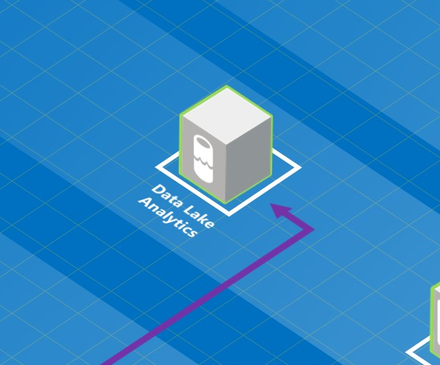
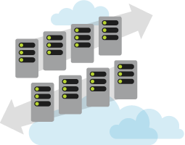
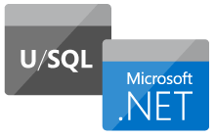
Data Lake
Analytics
PAYG Scalable Processing
New, Simple Querying Language
Notes:
The other side of things is Azure Data Lake Analytics – which is, at a stretch, the platform as a service offering of HDInsight. It’s scalable, pay-as-you-use compute, specifically for running massively distributed jobs.
When you run a job, you pick the amount of compute to use and pay for the uptime. When the job finishes, you stop paying. No need to build automation, remember to turn things off etc, it’s all done for you.
You use ADL Analytics by writing U-SQL, a new querying language introduced specifically for the tool. It’s origins lie with Microsoft’s own internal “Big Data” querying language, SCOPE, which has sits on an Apache YARN foundation. For long-term Hadoopers, YARN is essentially Map Reduce 2.0, a re-implementation of the querying language introduced to make massively parallel inexpensive compute across distributed storage possible.
Whilst there are usually a lot of eye-rolls when a new language is introduced, this is so similar to straight-forward SQL that there should be few barriers to people picking it up.

Slide 31
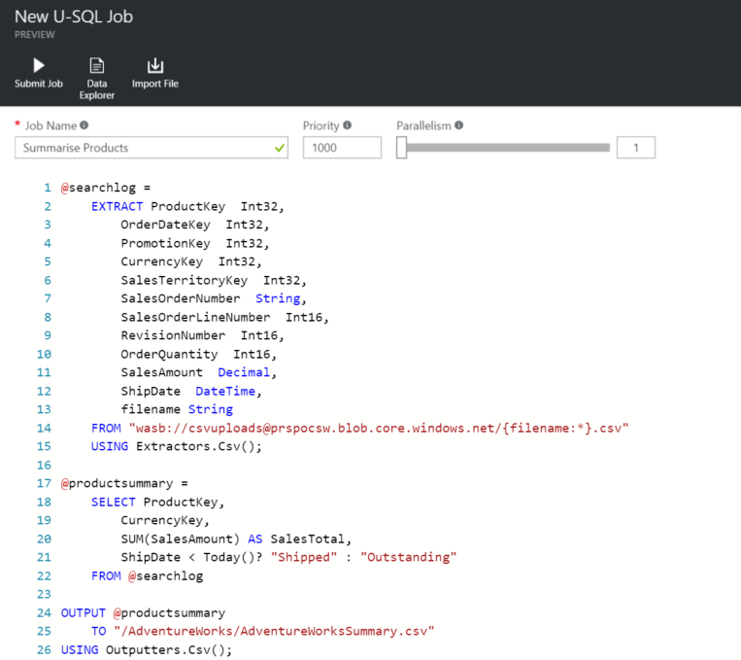
U-SQL
C# meets SQL
Natively Parallel
VS Data Lake Tools
Notes:
Firstly – you can do everything directly
So what does U-SQL look like? Well it usually the familiar SQL clauses – SELECT, FROM, WHERE and so on. You can use SUM, MIN, MAX and most of your favourite SQL functions. However, this all lives within a C# ecosystem – you’re using C# datatypes such as string and Int32, no sign of any varchars here!
Because it’s in a C# ecosystem, it’s massively extendable. You can write your own C# dlls and reference them within your SQL – there are also lots of pre-built functions that can be referenced directly.
There are a few new additions – when we’re referencing data held in flat files, we use the EXTRACT clause instead of SELECT, and this requires schema on read. As with polybase, we don’t have metadata against our flat files, so we need to specify column names and datatypes within each query.
We then use a USING statement to instruct the query on how to read the flat files. In the example above, we’re using an inbuilt CSV extractor.
BASED ON SCOPE
C# MEETS SQL
TOOLS
- EXECUTION PLAN
- CAPACITY MANAGEMENT
SYNTAX

Slide 32
Demo
Notes:
This demo largely follows the example I set out in my intro to ADL Analytics blog – you can find it here: http://blogs.adatis.co.uk/simon%20whiteley/

Slide 33
U-SQL
Data Lake Store
External Table
TEL
Warehouse Table
Azure Data Warehouse
Notes:
Let’s bring it back to our original point – how does this relate to ETL? Well in essence, we’re using targeted compute to process a specific job, in advance of bringing it into other analytical solutions. Essentially, whether we load the U-SQL output into our Data Warehouse, or whether we analyse it directly through Excel or PowerBI, we have transformed up front. TEL, in this example – we transform, then we move it to the end destination.

Slide 34
Why Cloud?
Azure Data Warehouse
Azure Data Lakes
The New BI Architecture
Notes:
TEL… ELT… Targeted up front compute or a scalable destination system. I’ve given you two wildly different choices, so let’s see how they may fit into a single architecture.

Slide 35
Data Lake Store
TEL
Scales for each job independently
Scales as a system
Data
Warehouse
ELT
Notes:
As a reminder, Data Lakes scale independently for each job, you apply compute to each and every action you take, and you pay only for what you use.
Data Warehouse scales as a system and you pay by the hour, regardless of what activity there is on the system.
So if I had 20 or so tables to load, which approach would I use?
Case 1 – One of the 20 tables is a monster, it has billions of rows and contains way more information than I would ever need. Certainly more than an end user would need to slice and dice by. The other tables are pretty small and require very little transformation. In this case, I’d throw some targeted compute at the large table using U-SQL, get it to a manageable size then suck it up into a Data Warehouse that doesn’t need scaling particularly.
Case 2 – The 20 tables are all fairly chunky and require transformations, although none are particularly cumbersome. In this case I’d scale up my ADW and work through the load, hopefully in a nice hour block.
But the reality is likely to be somewhere in the middle – a few U-SQL jobs providing up-front transform before extracting and loading into ADW for general transformation into our preferred data model.
So it’s not ELT, it’s not TEL..

Slide 36
TELT
Notes:
It’s TELT.
It’s a ridiculous example, I know. I just want to make sure that you go away challenging the original idea of “how we do things”. The technology has moved on to the point where there is no longer such a thing as “The way you move data”, it’s now a rich choice of options and patterns, each of which depends on the circumstances of your source data, your desired data model and the transformations required en route.

Slide 37
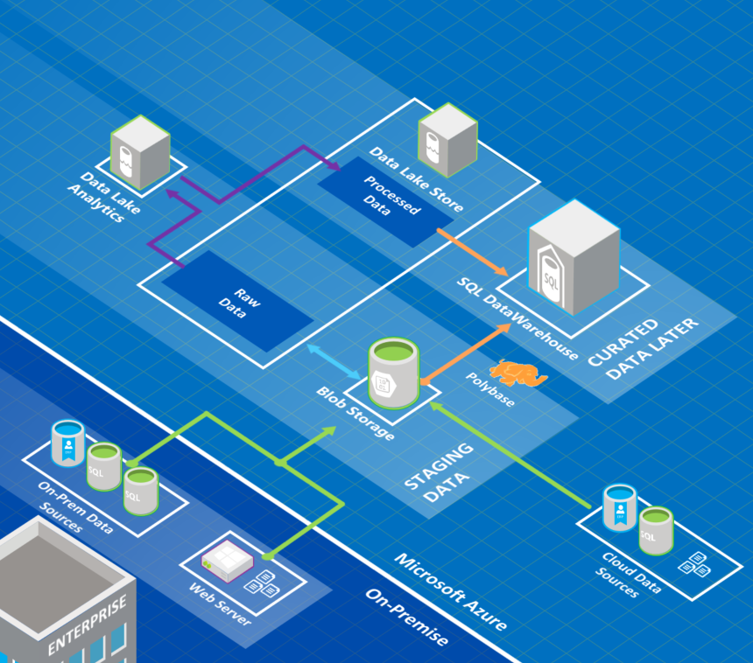
Notes:
I’ve knocked this shiny example of a foundation architecture together to demonstrate how things currently work.
You’ve got blob storage firstly, acting as a staging environment. All data, whether it’s database extracts, web log files, webservice outputs or streaming pipelines, can stage their data onto blob storage for us to access it. There’ll be some cases where you’d go directly to your end destinations, such as streaming analytics to PowerBI for realtime dashboards, but for our “batch load” scenario, we can stage the data neatly.
Some of this data will be polybased directly into our Azure DataWarehouse and transformed into our analysis model.
All of the data loaded is pulled into Data Lake Store, which acts as our Historical Data Store (HDS) layer, meaning we can go back and query over all of our raw data whenever we need to.
This data is then processed via U-SQL jobs and pushed into a curated area of the lake, ready to be pulled into ADW.
The inclusion of the Data Lake in this scenario doesn’t just give you the ability to throw compute at particularly difficult scenarios. It opens up opportunities for whole new areas of analytics. We have a rich store of everything we’ve ever needed to process which can be accessed via our statisticians and data scientists. We have a playground where we can perform new analysis, link into R, Azure ML, anything in between.
Maybe the output of this is a new measure that we want the less data-savvy to access via their dashboards. We can mature these findings from the Data Lake as processed outputs that get added to the Data Warehouse.
Essentially, including a lake means that we have an area without the strict development controls of a formal database, which acts to accelerate the learning and improvement of the warehouse itself.
That’s not to say the Data Lake doesn’t need strict controls to make sure it doesn’t turn into a free-for-all, it’s just a different type of workplace.
Sadly, this architecture has one or two gaps currently…

Slide 38
What’s Missing?
Polybase over Data Lake Store
Azure DW as U-SQL Destination
Upload to Data Lake Store Component
Azure DW Development Tools
Notes:
I’d love to be able to Polybase directly from the Data Lake into Azure DW. But unlike blob storage, which is essentially a HDFS store, ADLS is a WHDFS layer, which has not yet been implemented. You can direct the results of your U-SQL jobs directly into blob storage, but I’d actually prefer to have everything live within the data lake and do away with blob storage all together. This feature is coming at some point, but there’s no indication of when just yet.
You can’t write directly from U-SQL to the ADW; I can understand why this is a tricky one. The individual compute nodes of the U-SQL job would have to interact directly with the ADW compute nodes to achieve any efficiency – if the job pushed all inserts through the control node then it would be just as inefficient as SSIS or ADL. Again, this feature is on the roadmap so I’m interested to see how they achieve it.
The Data Lake upload is a little tricky currently – you can upload to blob storage very easily but integrating with Data Lake Store requires custom code or using additional command-line tools such as Sqoop. Hopefully we’ll be seeing some SSIS custom components before too long for our automated uploads, perhaps even using Sqoop under the covers. If not, I’ll likely end up building one myself.
Finally, ADW is not currently compatible with SQL Management Studio or with all features from SSDT. This is in the works and we should be hearing about it soon!
So – whilst there are gaps, each and every issue is being addressed and pushed forward. What we’re looking at is the PREVIEW version of this technology, which already has massive potential. Once these systems are released and mature, I have absolutely no doubt that these issues will all be resolved.
There is so much that we can do with this new structure, but it’s going to take a year or so of people trying it in the real world until we even realise how much potential it has! This is where BI is heading, these are the tools that I see changing our industry over the next few years.
It’s an exciting time to be an ETL guy…

Slide 39
Why Cloud?
Azure Data Warehouse
Azure Data Lakes
The New BI Architecture
Q & A
Notes:
The main questions we received were around use cases, I’ve included the most interesting one:
Q: Why would you aggregate in Lakes before moving to ADW?
A: It’s true that my example was spurious – using ADLA on a few hundred Mb of data is hardly a good use case. ADLA takes at LEAST a minute to allocate compute nodes, so it’s never going to be the performant option at those sizes. The real benefit is when you get to much larger sizes – terabytes and petabytes are ADLA’s bread and butter. But, same goes for ADW – it can handle such volumes so why not put them in? For me, this comes down to what you want to expose to your user and the type of data you’re dealing with.
Take Twitter feeds for example – we wouldn’t want to include the full metadata of every single tweet in ADW. Firstly, it’s a tool for performing aggregate calculations, not text mining, it simply wouldn’t perform well. Secondly, the user doesn’t need to see all of the data, and wouldn’t be able to make sense of most of it.
A more realistic scenario, is using U-SQL to perform term extraction and sentiment analysis and pushing that out as Fact & Dimension tables, which can then be used to augment an existing data model.
Also, ADW’s Polybase can only handle Delimited and Hadoop-format flat files, whereas U-SQL can shred through JSON, XML, PDFs… pretty much anything you can write extraction logic for. So maybe all your ADLA is doing is stripping out useful data into a state where it can be ingested!

Slide 40
sqlsurrey.sqlpass.org
@SQLSurrey
Notes:
Just a quick note – we’ve recently started the Surrey PASS Chapter. We’ll be meeting in Guildford once a month, talking about SQL Server, Azure, BI, Analytics and everything in between. We’re just getting started so the main thing we need is people! People to speak, people to provide ideas but, most importantly, people to come along and help us build a new community!
Also, we’ll buy the beer & pizza. That should be reason enough right?

Slide 41


Thanks for Listening
Simon Whiteley
Principal BI Consultant
@MrSiWhiteley
http://blogs.adatis.co.uk
Notes:
Feel free to get hold of me if you have any questions or thoughts about the tech, if you’re having trouble with anything, or if you just want to say hello.
Obviously, we’d be delighted to see if there’s any way Adatis can help you achieve your BI and Warehousing goals as well!
Thanks for Reading!

